Slide 1

Netty 4
Dima Ionut Daniel

Slide 2
Contents
What is Netty?
Architecture
Netty Features
Netty Client/Server
Netty Core
Netty Internals
Transport
Codec
Conclusions
Bibliography

Slide 3

What is Netty?
Netty is a non-blocking I/O(NIO) client/server framework for the development of Java network applications.
The asynchronouse event-driven network application and tools are used to simplify network programming such as TCP and UDP socket servers.
Netty also includes built-in HTTP protocol support, including the ability to run inside a servlet container.
Netty has support for WebSockets, integration with Google Protocol Buffers, SSL/TLS support, SPDY protocol, message compression.

Slide 4
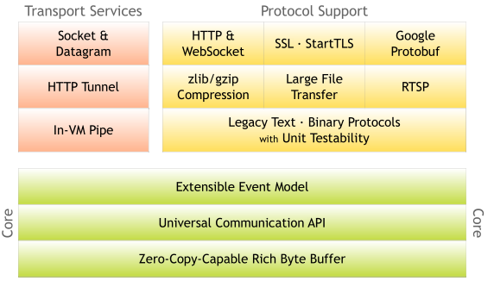
Architecture
Netty is very fast, performant, stable and flexible.
Netty is using the Separation of Cocerns pattern.

Slide 5
Netty Features
Design
Lots of APIs for various transport types, blocking and non-blocking socket
Flexible and extensible event model
Highly customizable thread model – single thread, one or more thread pools such as SEDA
Easy of Use
Well-documented Javadoc, user guide, examples
Performance
Better throughput, lower latency
Less resource consumption
Minimized unnecessary memory copy
Security
Support for SSL/TLS and StartLTS

Slide 6
Netty Features (cont.)
The entire Netty API is asynchronous.
Callback:
technique used with async procesing. Is passed to the method and executed after the method completes.
Futures:
represents a value that may become available at some point.
A Future object either holds the result of a computation or an exception.

Slide 7
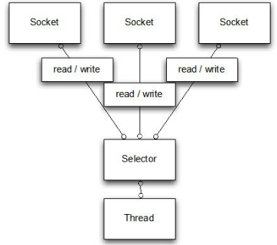
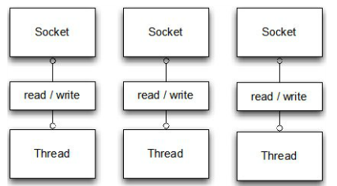
Netty Features (cont.)
Java NIO 2 was added in Java 7 and was designed for intensive I/O operations.
Network related tasks in Java approaches:
IO for blocking IO
NIO for new/non-blocking IO

Slide 8
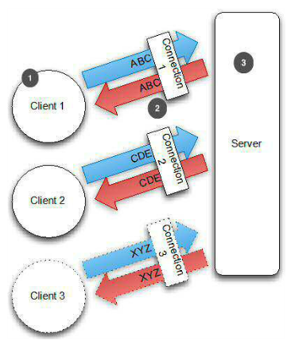
Netty Client/Server
1. Clientul se conecteaza la server.
2. Conexiunea se realizeaza pentru a trimite/primi date
3. Serverul trateaza clientii conectati.

Slide 9
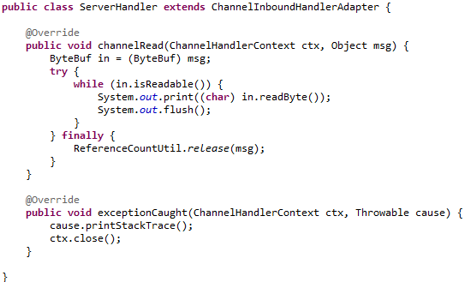
Netty Core
ChannelInboundHandler is used for reading/writing data over a socket.
We need to override the channelRead() method in order to receive data.
The received message is set into a ByteBuf object.

Slide 10
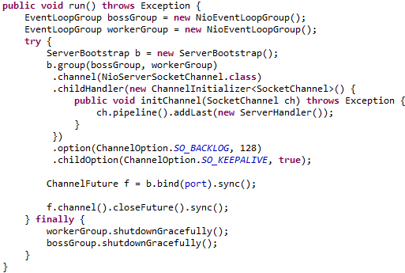
Netty Core (cont.)
NioEventLoopGroup is a multithread event loop that handles I/O operation.
ServerBootstrap is a helper class that is configuring the server.
We can set socket options like: tcpNoDelay, keepAlive.

Slide 11
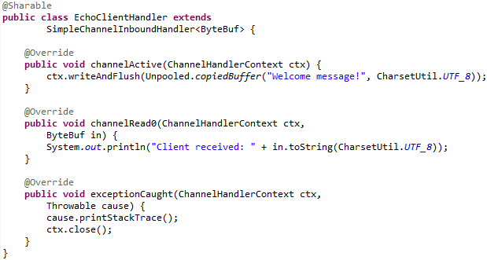
Netty Core (cont.)
The channelActive() method is called once the connection is established.
Once the connection is established a sequence of bytes are sent to the server

Slide 12
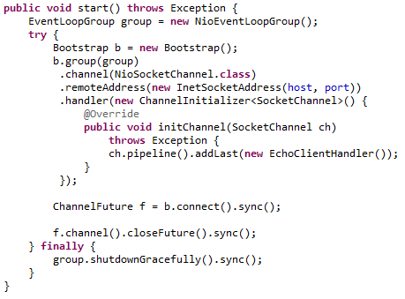
Netty Core (cont.)
Once the ServerBootstrap instance is created we'll create NIO transport.
NioEventLookGroup accepts new connections to handle accepted connections, read/write data.
We specify the InetSocketAddress to which the server binds.

Slide 13
Netty Internals
The ChannelInboundHandler receives messages and can also provide a response.
When Netty connects a client or binds a server it needs to know how to process in/out messages .
This is done via ChannelInitializer which add ChannelHandler implementations to the ChannelPipeline.
A ChannelInitializer it's also a ChannelHandler which automatically removes itself from the ChannelPipeline after it has added to the other handlers.

Slide 14
Netty Internals (cont.)
The EventLoop processes IO operations for a Channel.
A single EventLoop will typically handle events for multiple Channels.
The EventLoopGroup may contain more then one EventLoop and it's used to obtain an EventLoop.
A Channel is a representation of a socket connection or some component capable of performing IO operations.
All IO operations in Netty are done asynchronously.
In order to register listeners, Netty uses Futures and ChannelFutures.

Slide 15
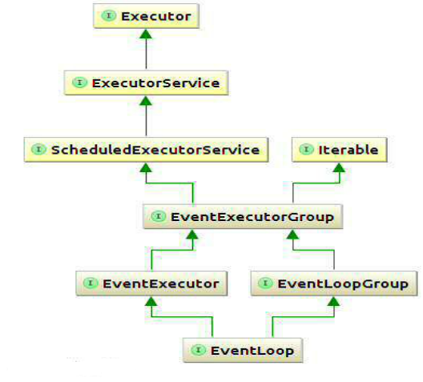
Netty Internals (cont.)
The EventLook is always bound to a single Thread.
When a channel is register, Netty "binds" that channel to a single EventLoop for the lifetime of that Channel.

Slide 16
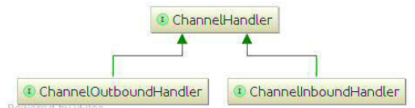
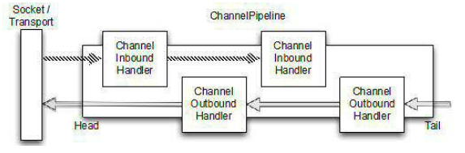
Netty Internals (cont.)
The ChannelHandler is processing data coming in/out from/to ChannelPipeline.
The ChannelOutboundHandler and ChannelInboundHandler are derived from ChannelHandler.
Netty has adapters for ChannelAdapter: ChannelHandlerAdapter, ChannelInboundHandlerAdapter, ChannelOutboundHandlerAdapter, ChannelDuplexHandlerAdapter

Slide 17
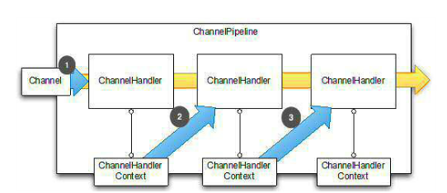
Netty Internals (cont.)
Events are passed to the first ChannelHandler in ChannelPipeline.
ChannelHandler passes event to next in ChannelPipeline using assigned ChannelHandlerContext.
If we try to add ChannelHandler to more than one ChannelPipeline that is annotated with @Sharable an exception is thrown.

Slide 18
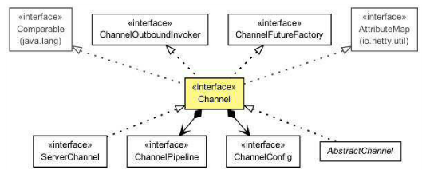
Transport
The ChannelConfig has the entire configuration settings stored for the channel.
The ChannelPipeline holds all the ChannelHandler instances that should be used for inbound/outbound.
We can modify ChannelPipeline on the fly, meaning we can add/remove ChannelHandler instances whenever needed.

Slide 19
Transport (cont.)
Netty contains useful transports:
NIO → selector-based approach
OIO → blocking streams
Local → local transport that can be used to communicate in the VM via pipes
Embedded → embedded transport

Slide 20
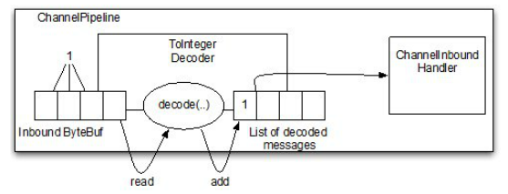
Codec
A codec is made up of 2 parts:
Decoder: responsible for decoding bytes to message
Encoder: encodes from a message back to bytes.
The ByteToMessageDecoder lets to write decoders that decode bytes to POJO objects.

Slide 21
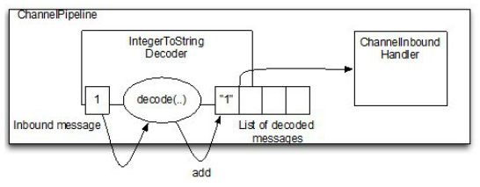
Codec (cont.)
If we decide we want to changed the message we can use MessageToMessageDecoder.

Slide 22
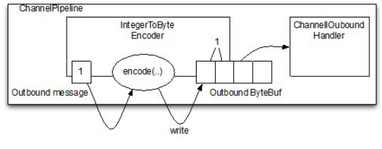
Codec (cont.)
Encoder allow encoding the messages to bytes or other message.
Clases like ByteToMessageEncoder or MessageToByteEncoder are used.

Slide 23
Conclusions
Netty is easy to use.
Netty is documented.

Slide 24

Bibliography
http://en.wikipedia.org/wiki/Netty_(software)
Manning - Netty in Action

